Slide 1

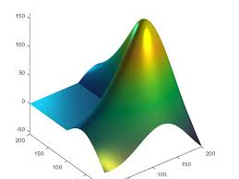
ENGR 4399 Introduction to Machine Learning for Engineers
Lecture 9: Low Dimensional Visualization and Clustering

Slide 2
In-Class #6a: Tables
1) load the patient data from the excel spreadsheet patients.xls
2) What categories are there for the Self Assessed Heath Status?
3) Find the patients who are over 6 ft and are smokers

Slide 3
Introduction to Clustering
Clustering: the process of grouping a set of objects into classes of similar objects
Data within a cluster should be similar
Data from different clusters should be dissimilar
Looking for hidden patterns and structures within the data
The commonest form of unsupervised learning
Unsupervised learning = learning from raw data, as opposed to supervised data where a classification of examples is given

Slide 4
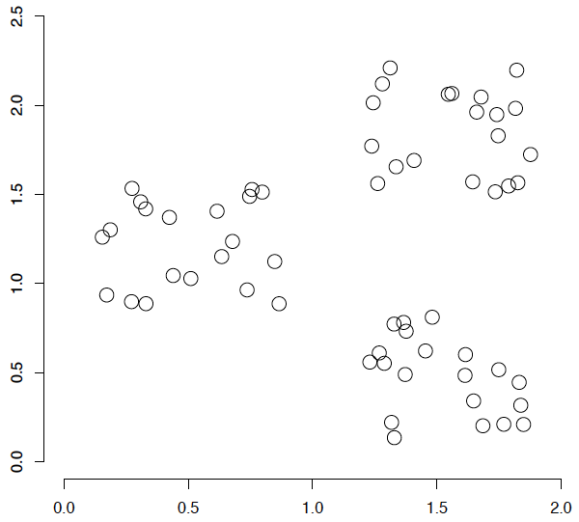
A data set with clear cluster structure
Ch. 16
How would you design an algorithm for finding the three clusters in this case?

Slide 5

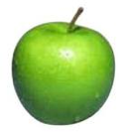

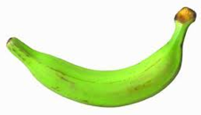
Supervised learning
label
label₁
model/
predictor
label₃
label₄
label₅
Supervised learning: given labeled examples

Slide 6
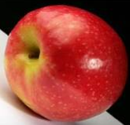
Unsupervised learning
Unsupervised learning: given data, i.e. examples, but no labels

Slide 7
Unsupervised learning
Given some example without labels, do something!

Slide 8
Unsupervised learning: clustering
Raw data
features
f₁, f₂, f₃, …, f_{n}
f₁, f₂, f₃, …, f_{n}
Clusters
f₁, f₂, f₃, …, f_{n}
f₁, f₂, f₃, …, f_{n}
group into classes/clusters
extract
features
f₁, f₂, f₃, …, f_{n}
No “supervision”, we’re only given data and want to find natural groupings

Slide 9
Unsupervised learning: modeling
Most frequently, when people think of unsupervised learning they think clustering
Another category: learning probabilities/parameters for models without supervision
Learn a translation dictionary
Learn a grammar for a language
Learn the social graph

Slide 10
Clustering
Clustering: the process of grouping a set of objects into classes of similar objects
Applications?

